Slide 1
Myth 2-3. Biggest correlating variables on Covid deaths are Diabities and Heart Desease and negative correlation exist to GDP per capita
Main Hypothesis: Countries income will impact in hability to have lower COVID deaths and pleaces with higher Diabeties and Heart deases rates will have a higher Covid death rate
Process:
1. Get data sources and preparing DataFrames
2. Univariate Model between GDP per Capita and Covid Deaths
3. Multivariate analysis to determine variables with more correlation to Covid Deaths
4. Arrive to conclusions

Slide 2
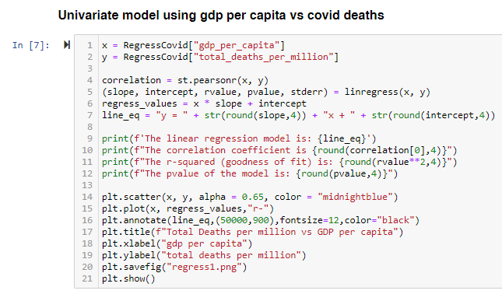
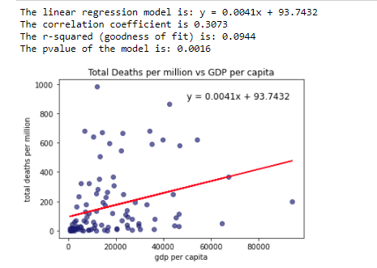
Myth 2: The larger the GDP per Capita the Lower the Covid Deaths
Regression model to determine the correlation between the GDP per Capital and Covid Deaths, using GDP as predictor
Despite the model has statistical significance, no strong correlation exists between GDP per Capita and Covid Deaths

Slide 3

Myth 3: Strong correlation between Covid deaths and Diabities and Heart Desease
Multivariate Analysis to determine those variables with the strongest lineal relationship with Covid Deaths

Slide 4
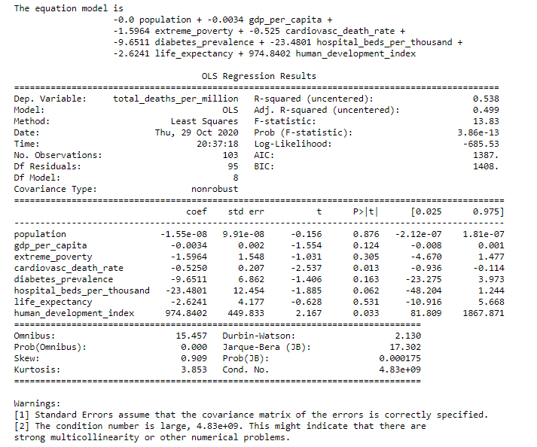
Myth 3: Strong correlation between Covid deaths and Diabities and Heart Desease
Trial #1 Multivariate Analysis using 8 variables

Slide 5
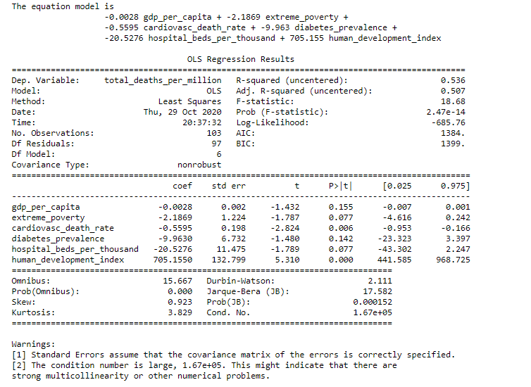
Myth 3: Strong correlation between Covid deaths and Diabities and Heart Desease
Trial #2 Multivariate Analysis dropping «population» and «life expectancy»

Slide 6
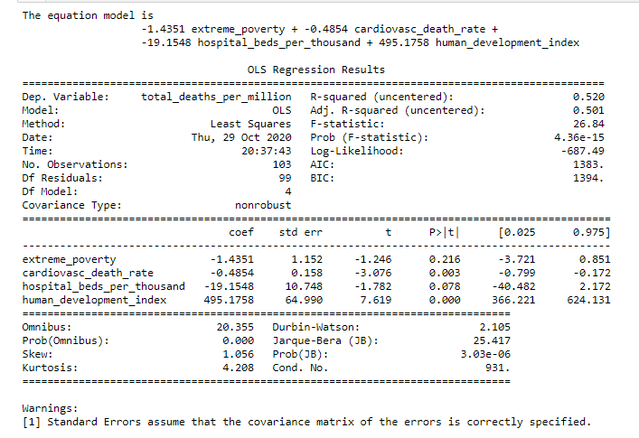
Myth 3: Strong correlation between Covid deaths and Diabities and Heart Desease
Trial #3 Multivariate Analysis dropping «gdp per capital» and «diabetes prevalence»

Slide 7
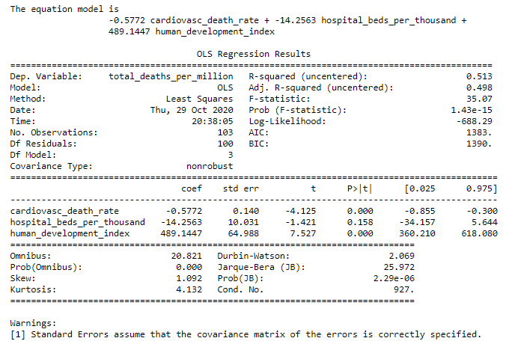
Myth 3: Strong correlation between Covid deaths and Diabities and Heart Desease
Trial #4 Multivariate Analysis dropping «extreme poverty»

Slide 8
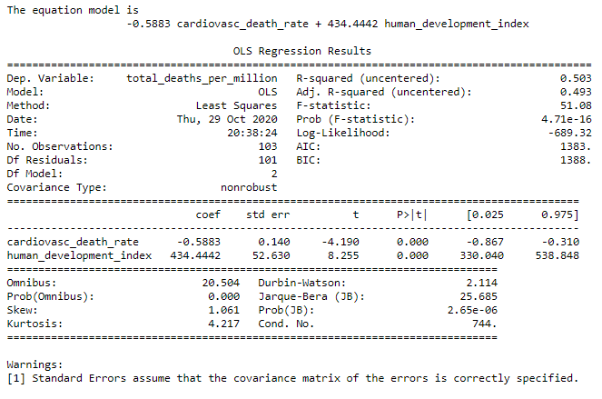
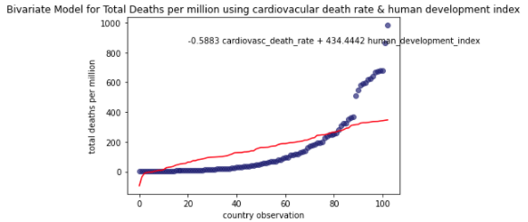
Myth 3: Strong correlation between Covid deaths and Diabities and Heart Desease
Final Multivariate Model using only cardiovascular death rate and human development index
Using a Bivariate model with cardiovascular death rate and human development index has a predictive power of 50.3% of the variance of Covid Deaths

